Slide 1

Final Project: Top Investments GIS Real Estate Web Application
Yoram Accri, Gavriel Akshikar, Eyal Duzy
Apr 2025

Slide 2
Top Investments Value-proposition
For
Top Investments is a platform that serves US real-estate investors
Who need
User friendly platform consolidating assets from multiple providers
Top Investments provides
Standardization of data for efficient selection process
Accelerated Decision making process (supported by ROI calculations)
Decision making efficiency
Attention to user friendliness, usability and design
Notes:
Today investors experience involve difficult gathering of non standard data formats We invested a lot in UI and design – colors consistency, overall look & feel and appearance

Slide 3
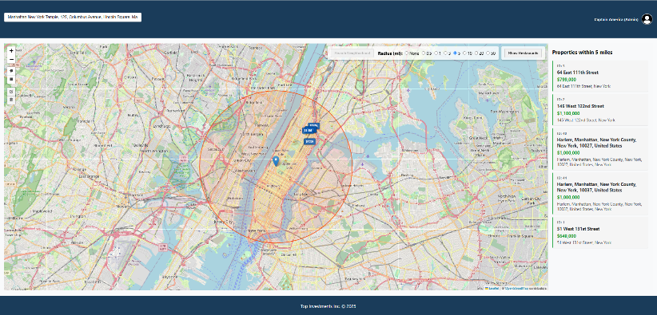
Project implementation Overview
Full-stack web app for real-estate property data search and management
Built with React (frontend), Node.js/Express (backend), MongoDB Atlas (database)
Integrates geospatial data using OpenStreetMap with Leaflet & Nominatim API
Notes:
Node – run JS with no browser express – run server Cors – enable rest API use (Get, Pull)

Slide 4
Main challenges and our work method
Teamwork
We assigned a team lead that orchestrated the project execution
On-going team sync meetings
GitHub and versions merge
Pre-merge testing and only one was authorized to merge
Work scope and phases
Assessment of product design vs Requirements, Production, Freeze, QA, Delivery
Development done on features branches
Notes:
product design vs requests –
For example: Adding data layer and layer control, Radius search, added support for smaller screens in the CSS for “responsive UI”,

Slide 5
System Architecture
Frontend: React (invest_FE)
Components for search, filtering, property display, and forms
Backend: Node.js/Express (invest_BE)
RESTful API, geospatial queries, authentication
Database: MongoDB
Stores property, user, neighborhoods and Restaurants data with geospatial indexing

Slide 6

Summary
Thank you !
All project requirements are addressed
Robust, scalable, and user-friendly GIS web application
Ready for demonstration and set for further enhancements

